Slide 1
Books Management System
Team Sai Teja Maredupalli Prasad Tejamanikanta Gudla

Slide 2
Contents
Objective
Scope
User Requirements
Business Rules
ER-Diagram
Data Dictionary of the System
Data Base
Conclusion
Future Enhancement

Slide 3
Objective
The aim of this project is to build a Book Management System
This system can be build based on few factors like books, authors, sales, publisher, awards and editions.
This system can create and update new data of books into system. Users can also view the current books available.

Slide 4
Scope
The main scope of the project is to help user to view and search for the books and their respective edition, author and price in the database.
This can help to search the requirements of the specific user easily.
This Book Management system can also store book sales data for the previous sold books records.
We can also analyze the data of the books and their properties.

Slide 5
User Requirements
Users can find a book and its details using this database.
We can see what book had Series of book.
Users can see editions of each book.
Prices of the books
And sales based on which quarter, and we have Q1, Q2, Q3 and Q4.
We can view the details of the author.

Slide 6
Business Rules
one book can have multiple authors, but each author can only write one book.
one book can have multiple editions, but each edition belongs to only one book.
one book can be checked out multiple times, but each checkout is for only one book.
one book can have multiple ratings, but each rating is for only one book.
one author can have only one info record, and each info record belongs to only one author.
one info record can have only one series, and each series belongs to only one info record.

Slide 7
Business Rules
one info record can have only one book, and each book belongs to only one info record.
one book can win multiple awards, and each award can be won by multiple books.
multiple books can have the same publisher, but each book can have only one publisher.
one publisher can publish multiple editions, but each edition is published by only one publisher.
one publisher can make multiple sales, but each sale is made by only one publisher.

Slide 8
Business Rules
multiple sales can be made for the same edition, but each sale is for only one edition.
multiple sales can include the same item, but each item is sold in only one sale.
multiple sales can belong to the same order, but each sale is for only one order.
one book can belong to multiple genre series, and each genre series can have multiple books.

Slide 9
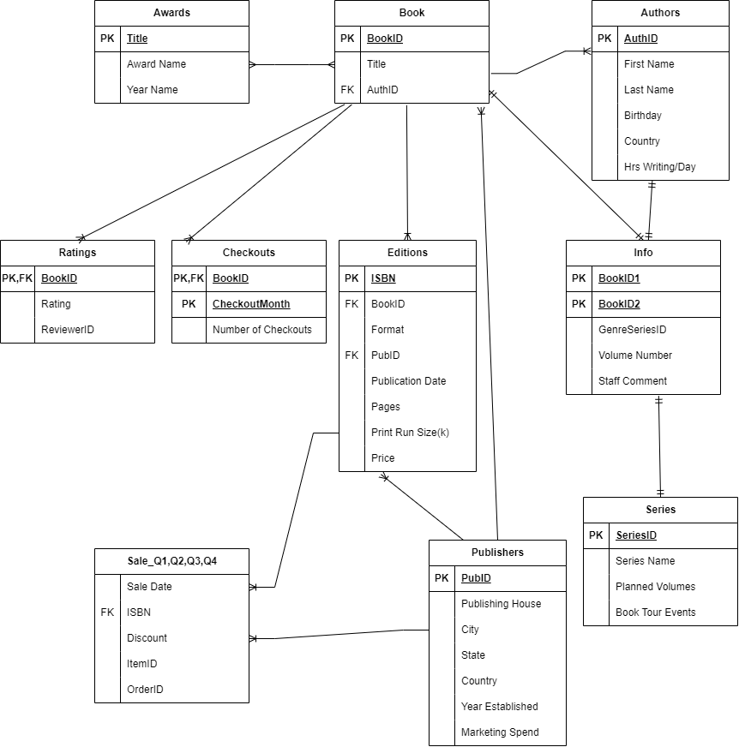
Entity-Relation Diagram

Slide 10
Data Dictionary of the System

Slide 11
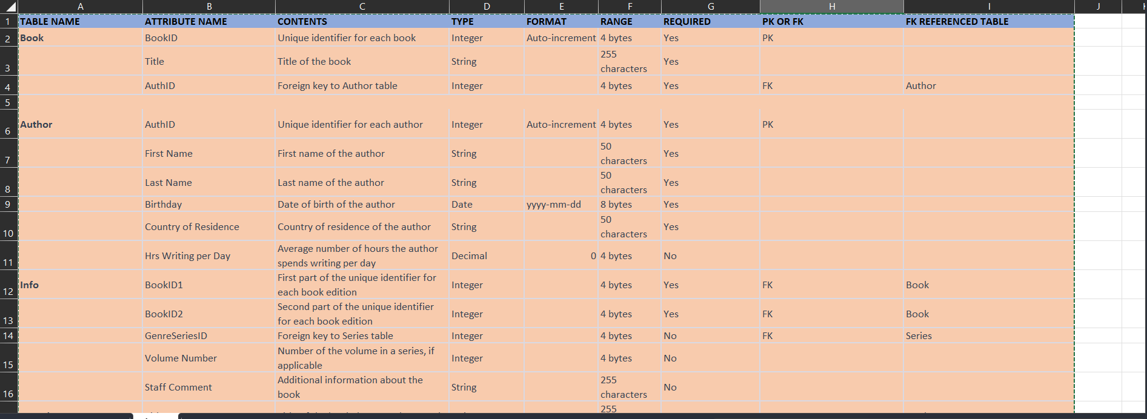
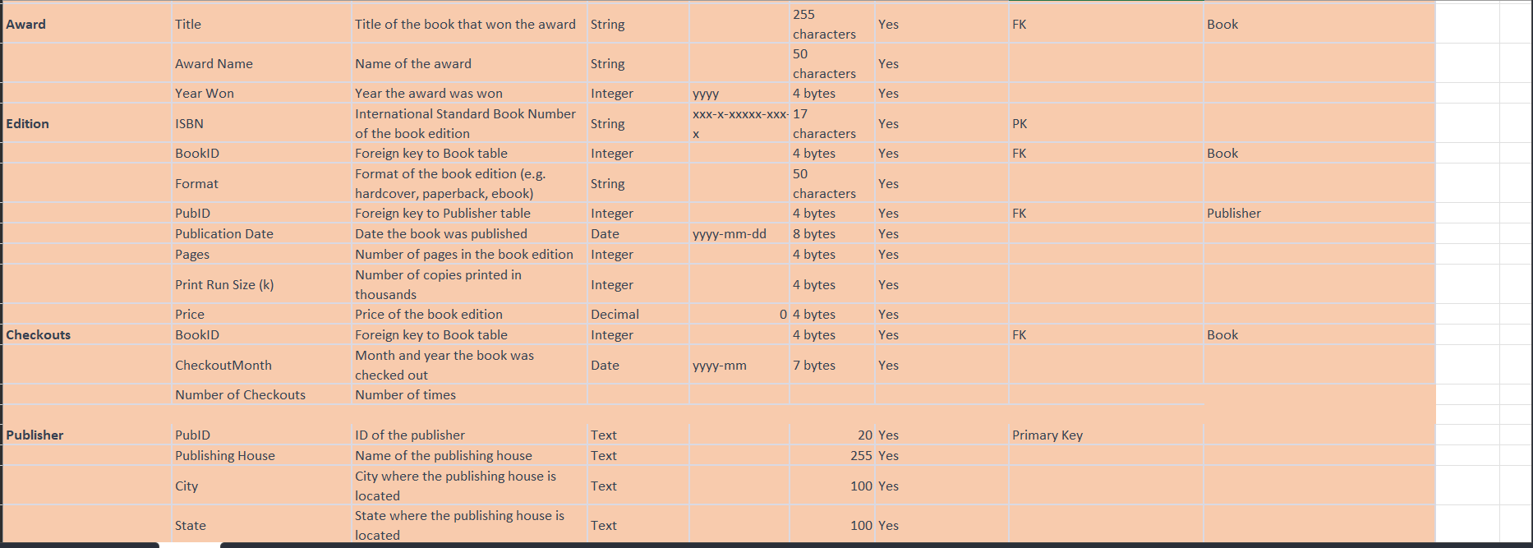

Slide 12
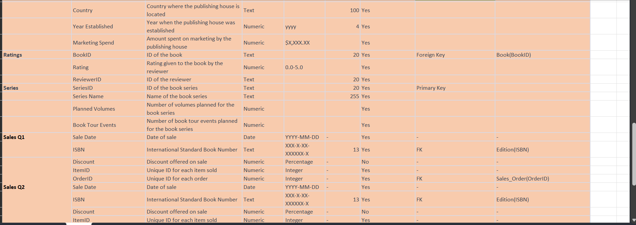
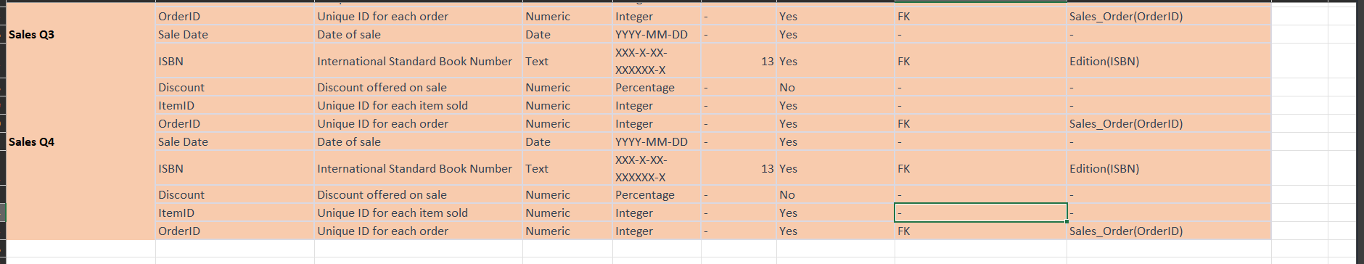

Slide 13
Data Base
In order to create a database management system for the Books Management System, we can use SQL Workbench, a software tool that provides a user-friendly interface and is compatible with various operating systems. SQL Workbench allows us to optimize our queries and execute them efficiently with its advanced tools. It also provides us with the flexibility to configure high cluster servers and master-slave configurations to enhance the system's performance. One of the major benefits of using SQL Workbench is its graphical visualization tools, which enables us to design and optimize schema and queries. We can create complex ER models with ease and utilize features that facilitate efficient modeling and designing of the database.

Slide 14
Data Base
Overall, SQL Workbench is an excellent choice for developing the database management system for the Books Management System, as it offers us the necessary tools and features to optimize and manage our data effectively. We can use MySQL's powerful tools to manage and optimize the created database, including designing and optimizing schema and queries, creating tables, and inserting, updating, or deleting data. MySQL's database management system is widely used and offers high performance, scalability, and reliability.

Slide 15
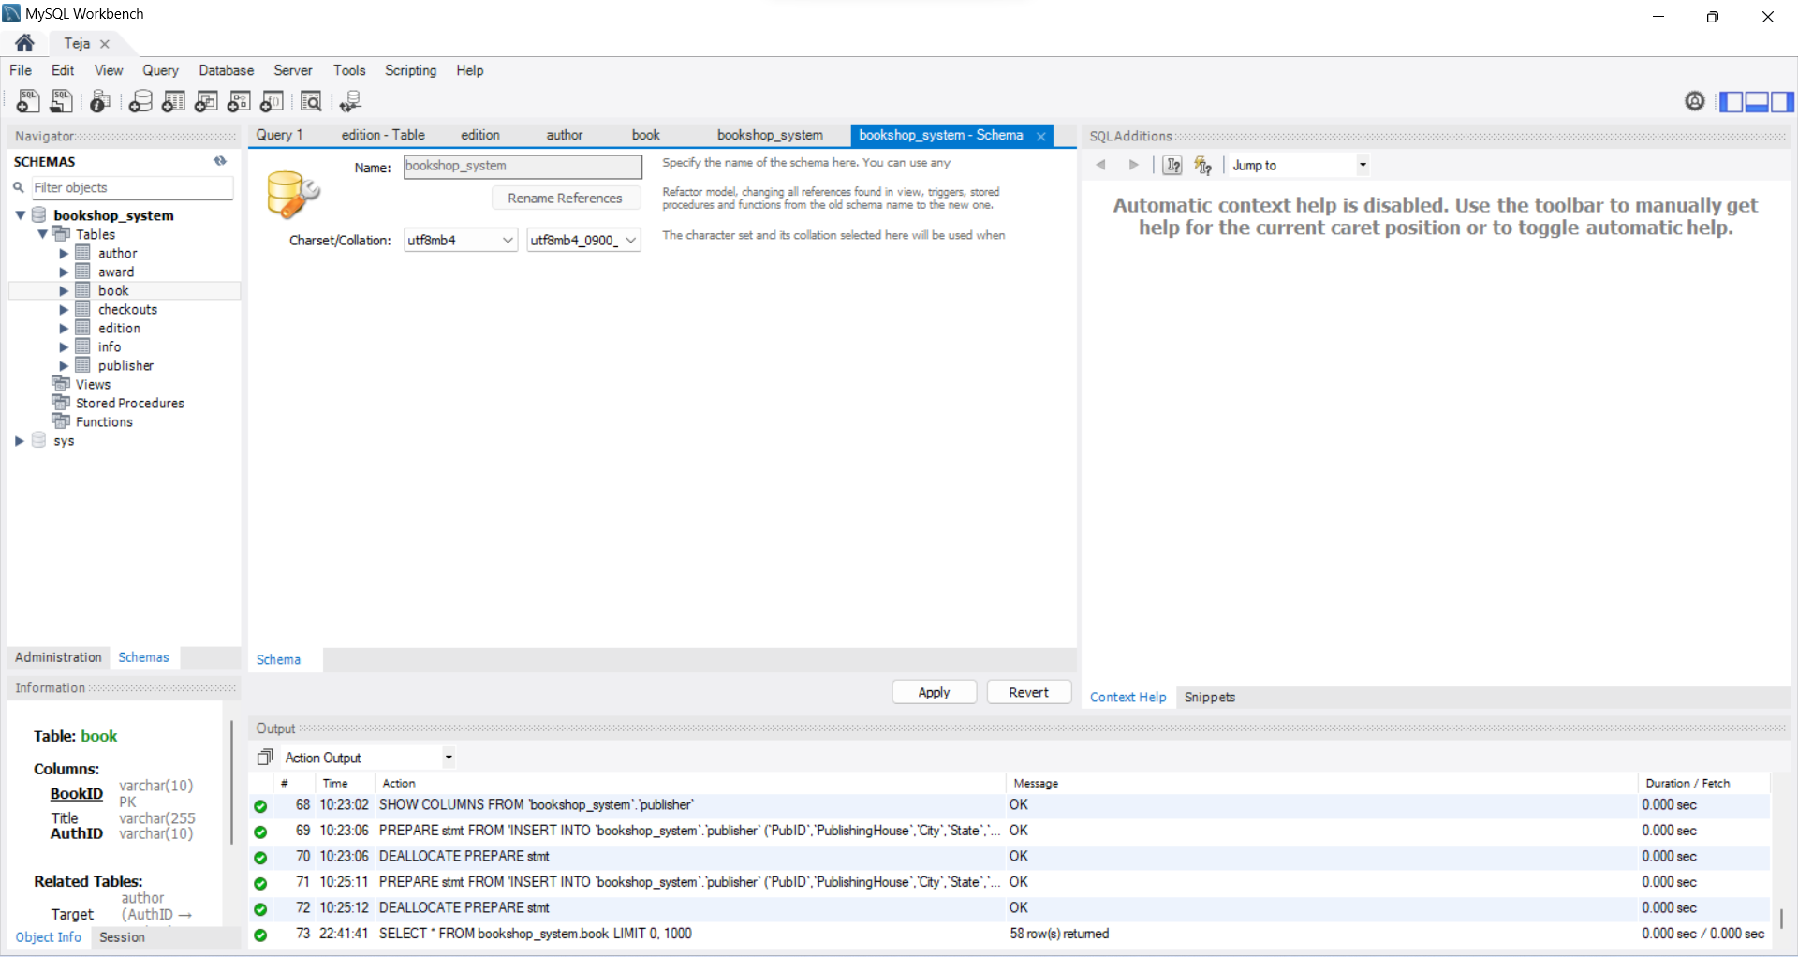
A schema is created for the Database

Slide 16
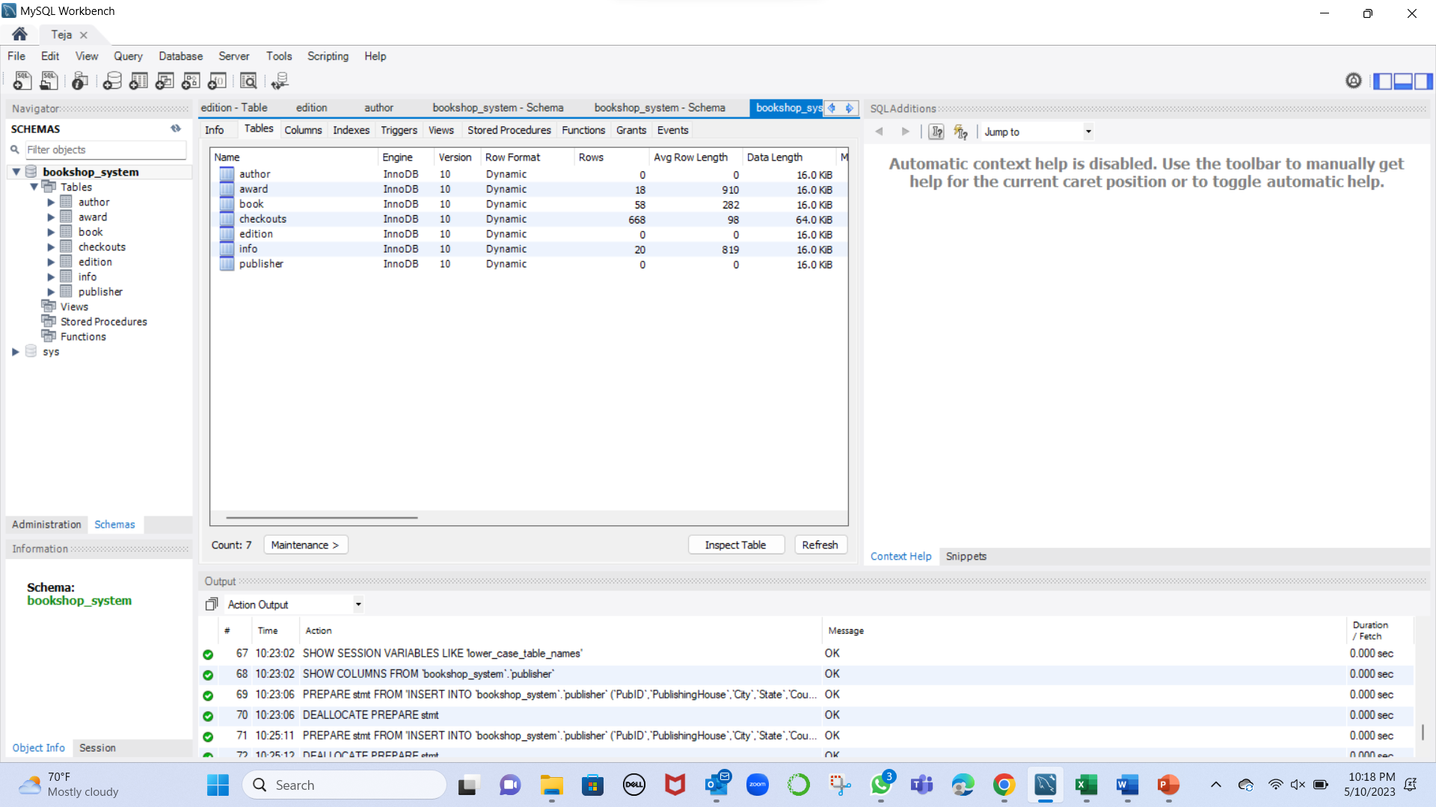
Some of the Tables in the Database

Slide 17
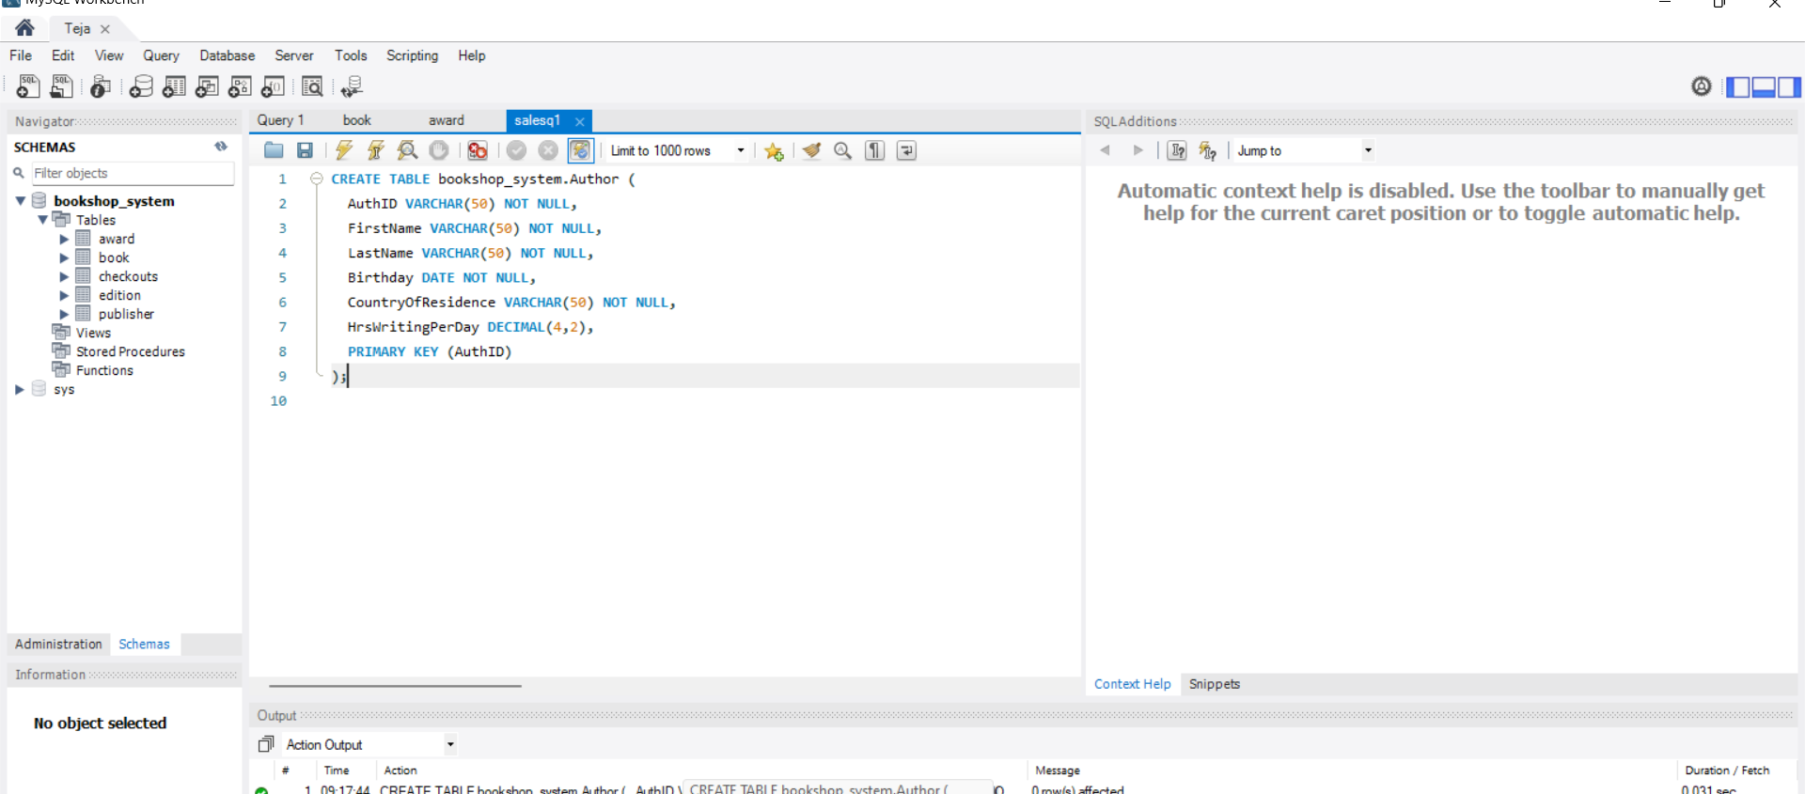
Creating a Table Author

Slide 18
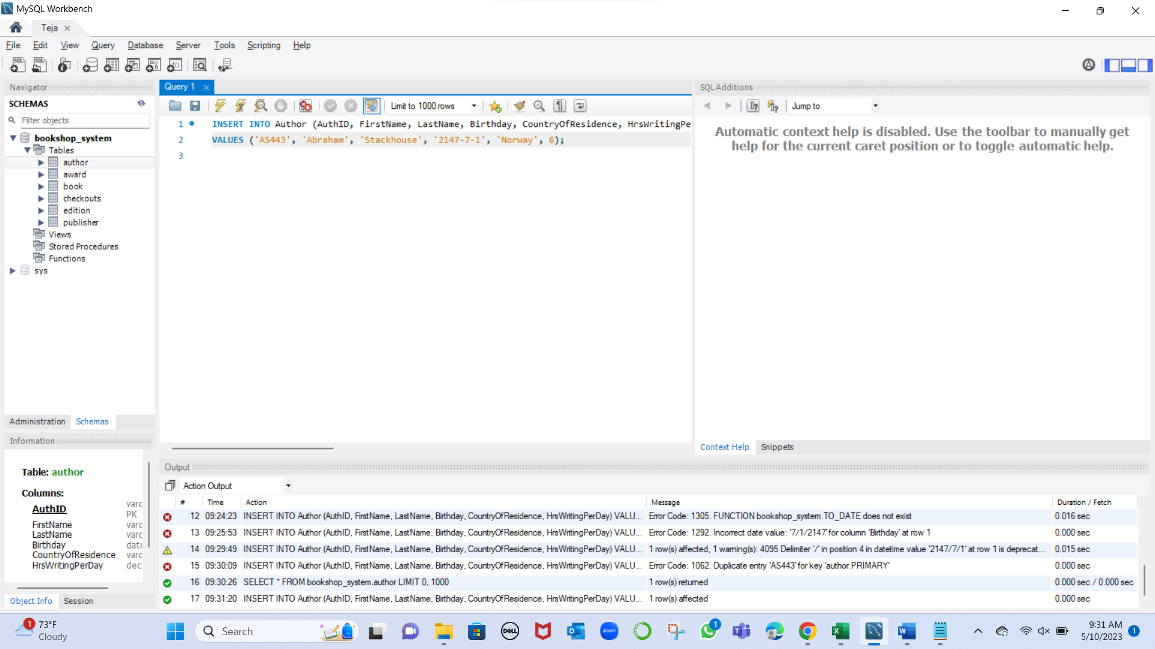
Inserting data into the table Author

Slide 19
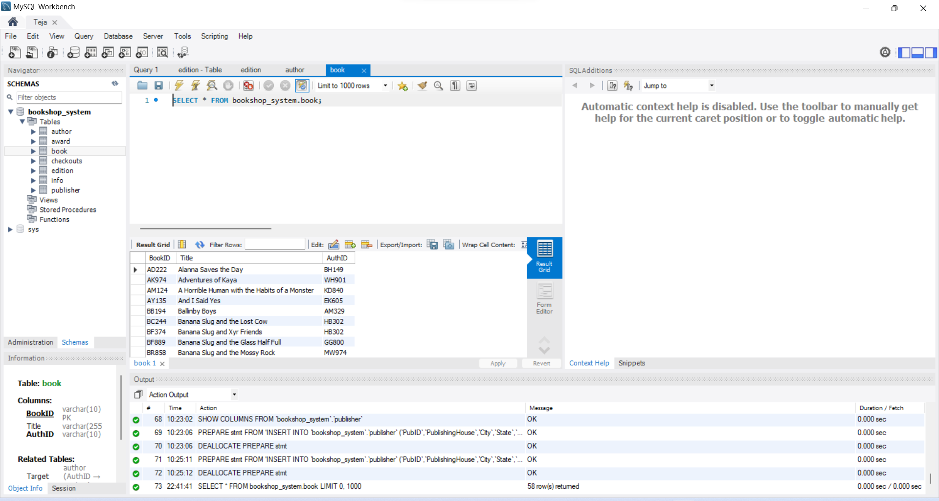
Retrieval of Table Book records

Slide 20
Conclusion
By using the above Database created to use the Books Management System. Users can retire the information of books, its details and update the latest records.
In future we can include this database to the User Interface and it can be helpful for users which will be user friendly.

